Slide 1
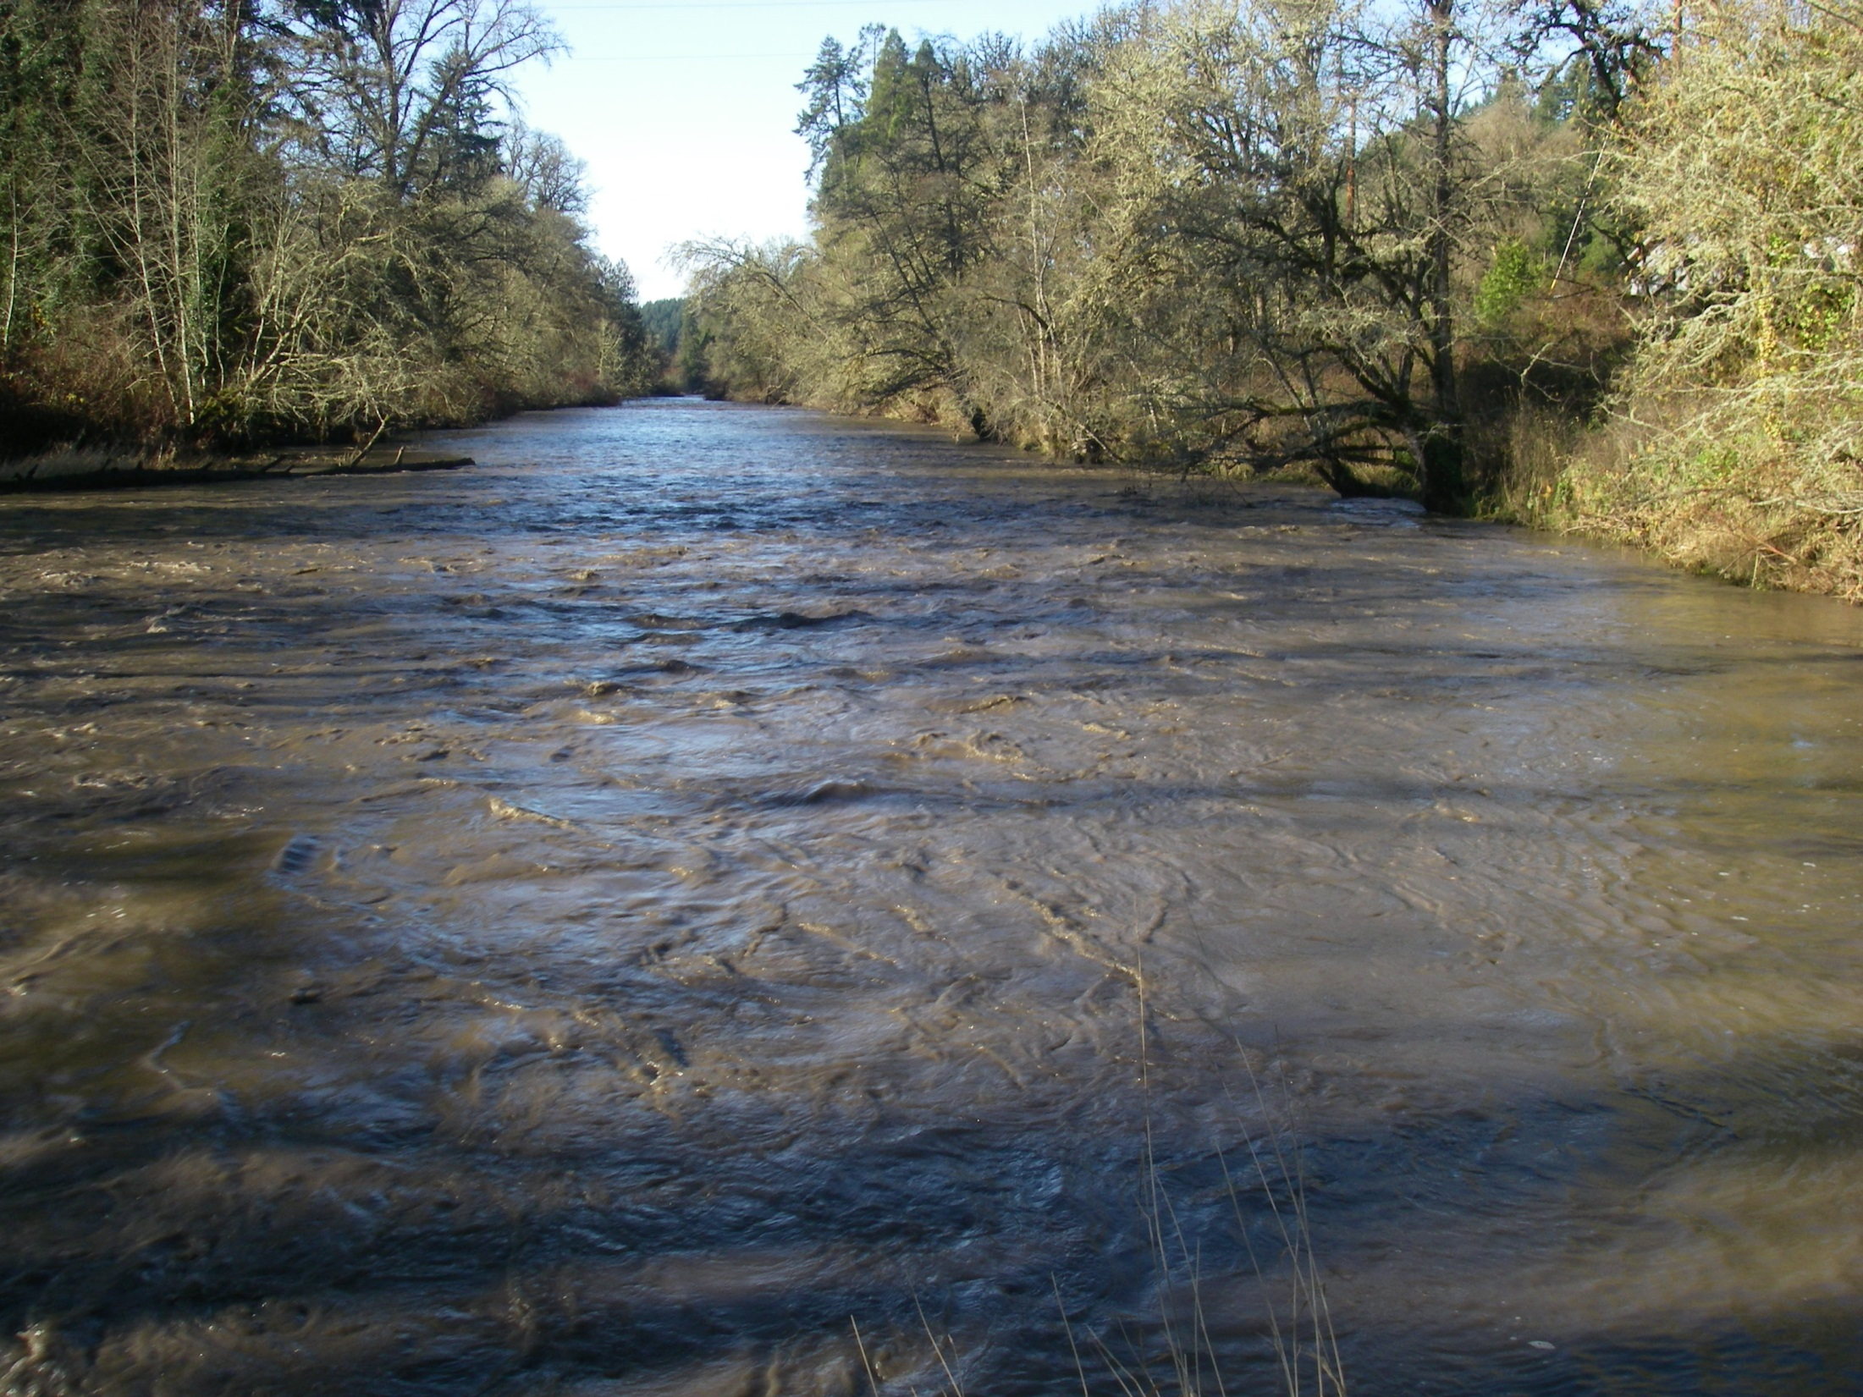

Effects of the Fall Creek reservoir drawdowns on downstream off-channel habitats
Brian Bangs, Paul Scheerer, and Shaun Clements
Native Fish Investigations Project
Oregon Department of Fish and Wildlife

Slide 2
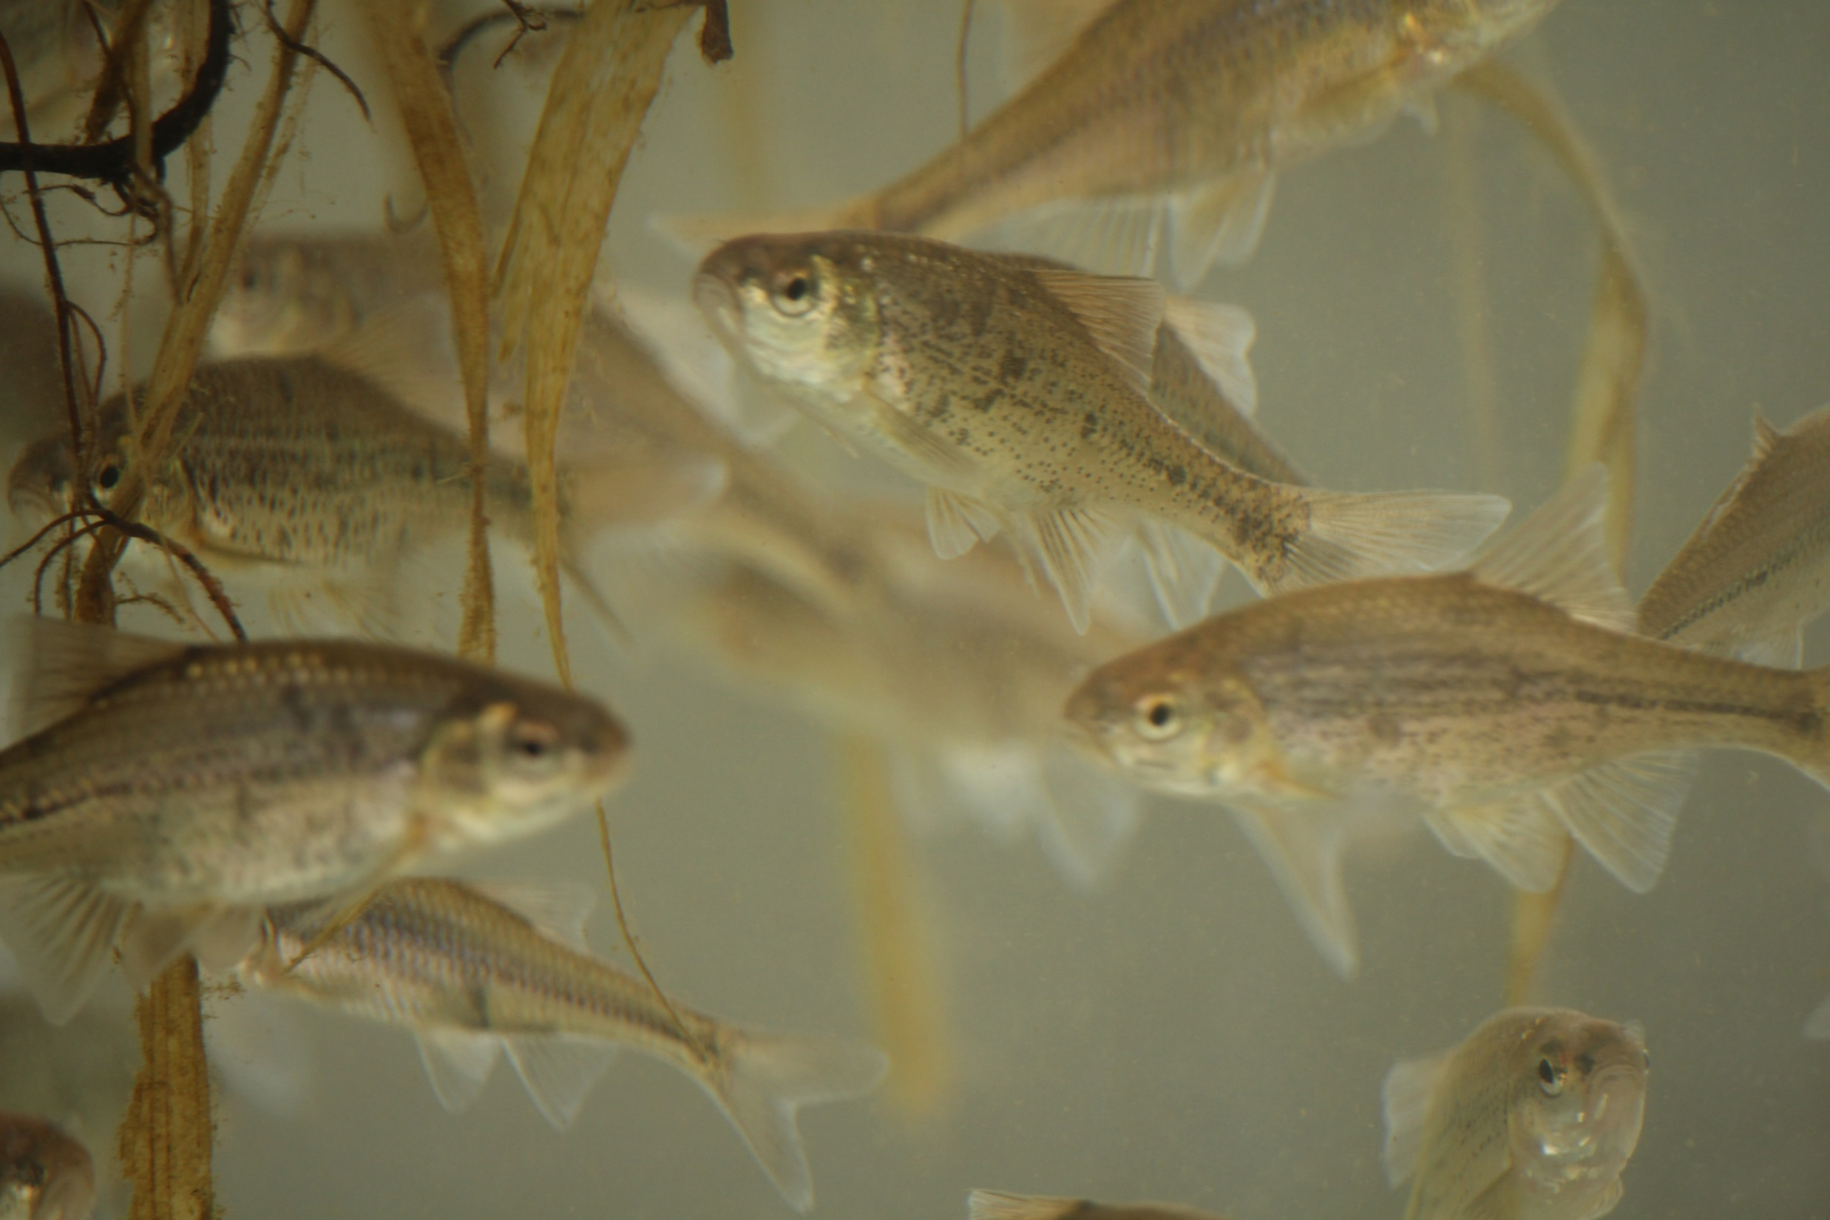
Quick Oregon Chub Updates
Proposed delisting: Feb. 2014
Final delisting: Feb. 17, 2015
Post-delisting monitoring
  Nine year period
  Track distribution, abundance, and monitor threats

Slide 3
Quick Oregon Chub Updates
OPB Oregon Field Guide
Feb. 26 at 8:30 PM
Army Corp’s Greg Taylor interview

Slide 4

Fall Creek Drawdown Study
ACOE experimenting with reservoir drawdown (run of river operation)
Facilitate downstream movement of juvenile salmonids
  Economical alternative
  Huge sediment load enters river downstream as new channel carved into reservoir bed

Slide 5
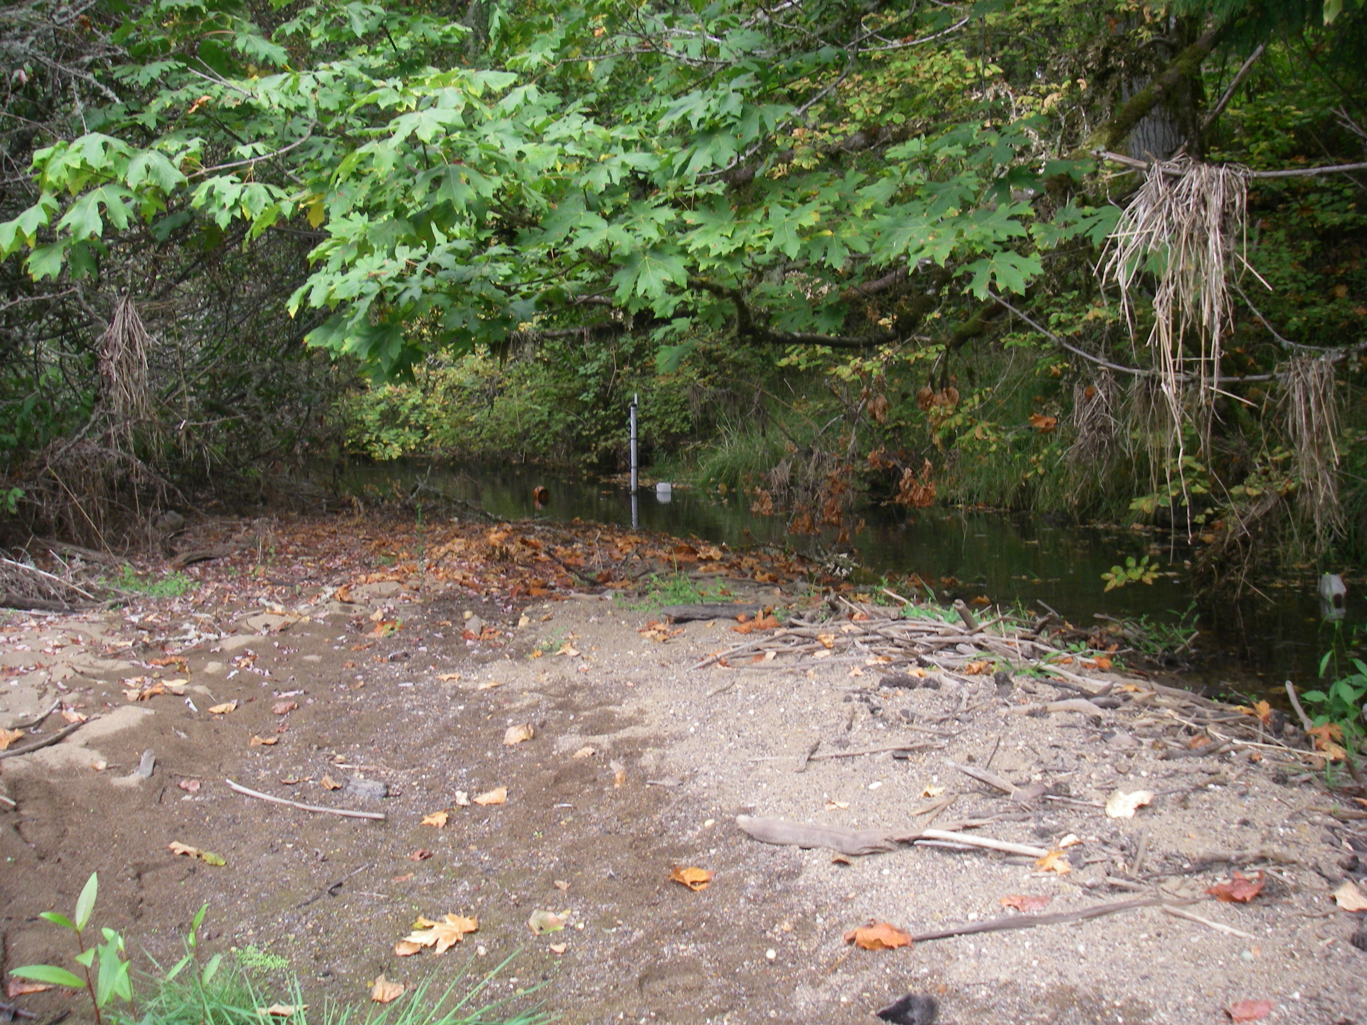
Fall Creek Drawdown Study
Concerns about effects of Fall Creek Drawdown on off-channel habitats and fish communities

Slide 6
Fall Creek Drawdown Study
Monitor changes related to Fall Creek Reservoir drawdown
  Habitat, fish assemblage
Selected 4 sites to study with Floodplain Study methods

Slide 7
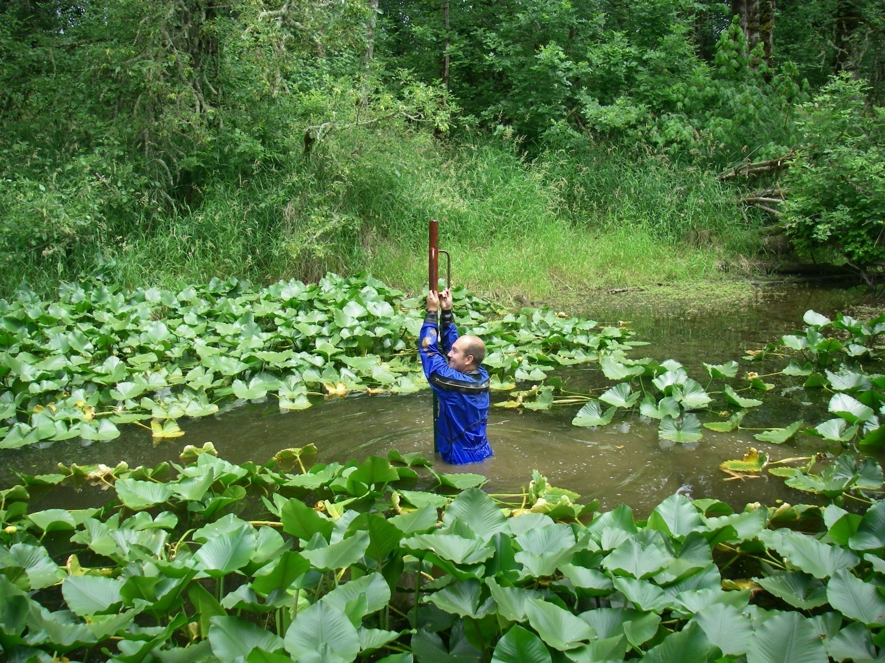
Approach
Monitor water levels
2) Monitor temperatures
3) Determine the relationships between water levels and habitat availability (pond volume)
4) Identify the points of hydrologic connection
Notes:
Could we add PIT-tag study?

Slide 8
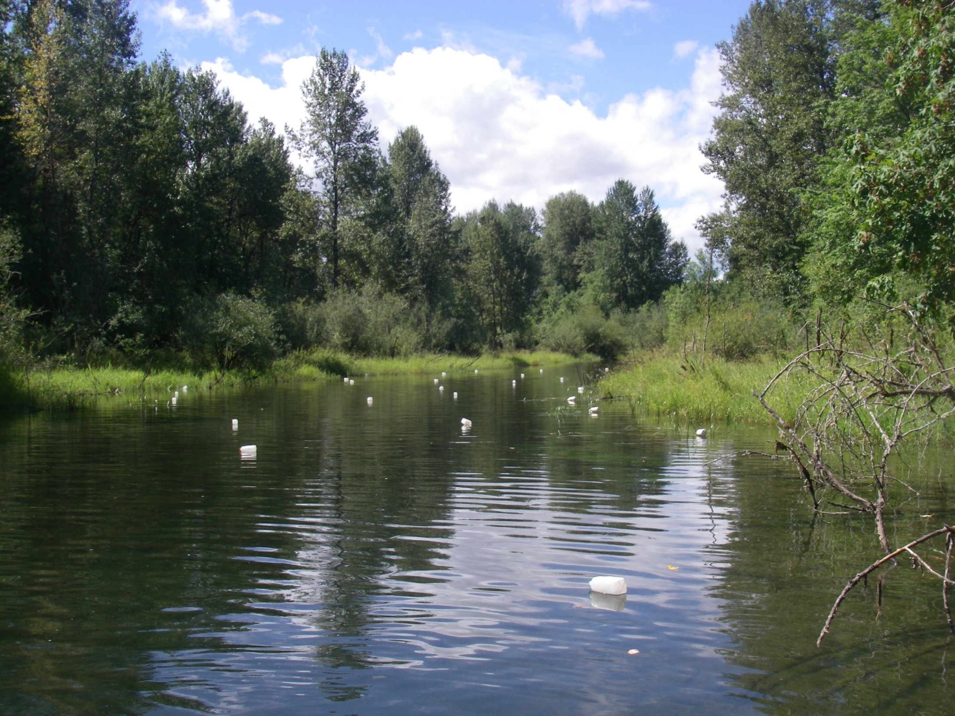
Approach
5) Determine changes in substrate
  Remap bathymetry
6) Describe Fish Assemblages
  Describe composition of fish assemblages (species diversity and abundance), natives vs. non-natives

Slide 9
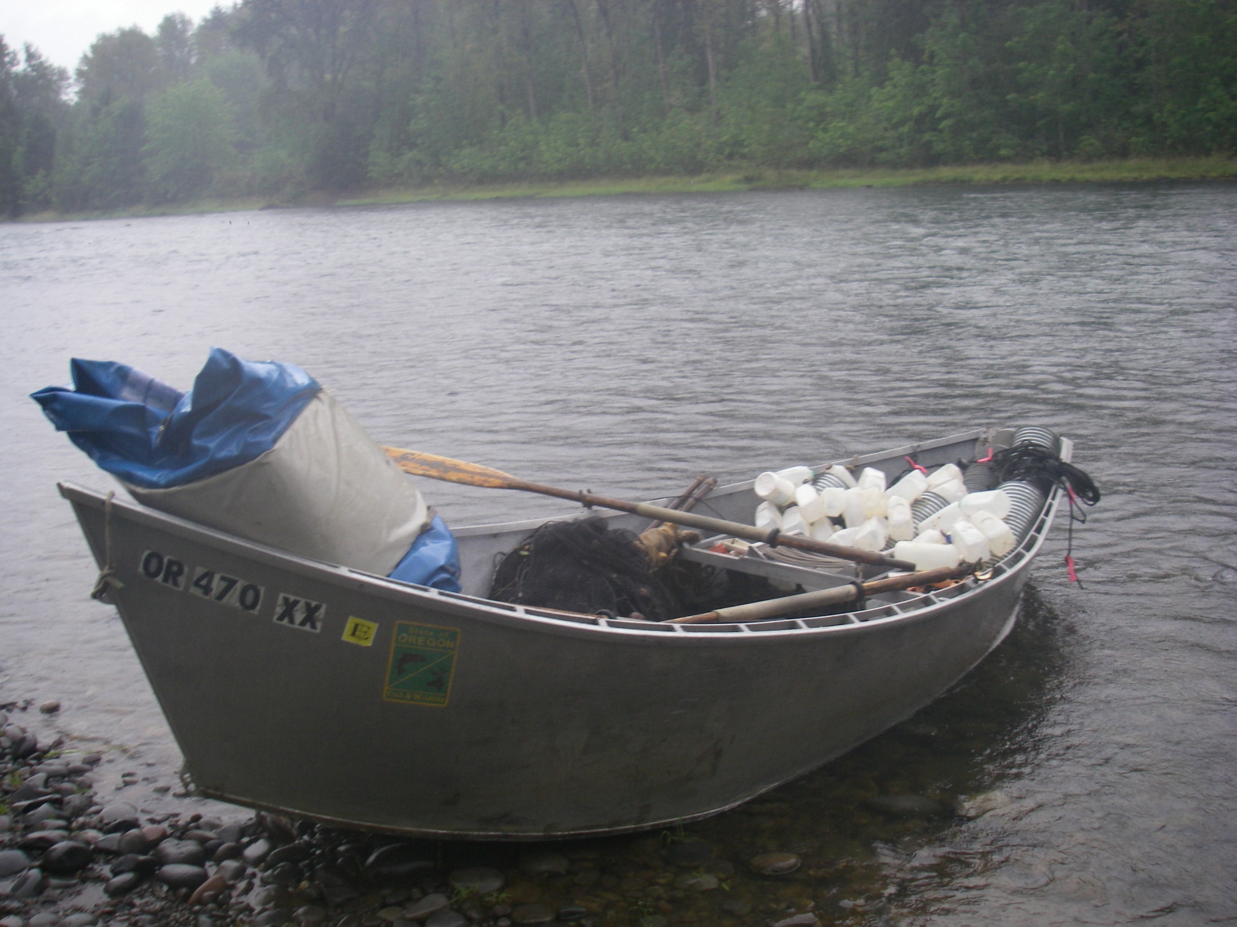
Goal
Determine the effect of drawdowns on:
Bathymetry (sedimentation),
Habitat characteristics,
Temperature regimes,
Timing, frequency, duration, magnitude of connection, and
Fish assemblage structure in off-channel habitats in Fall Creek, below the reservoir

Slide 10
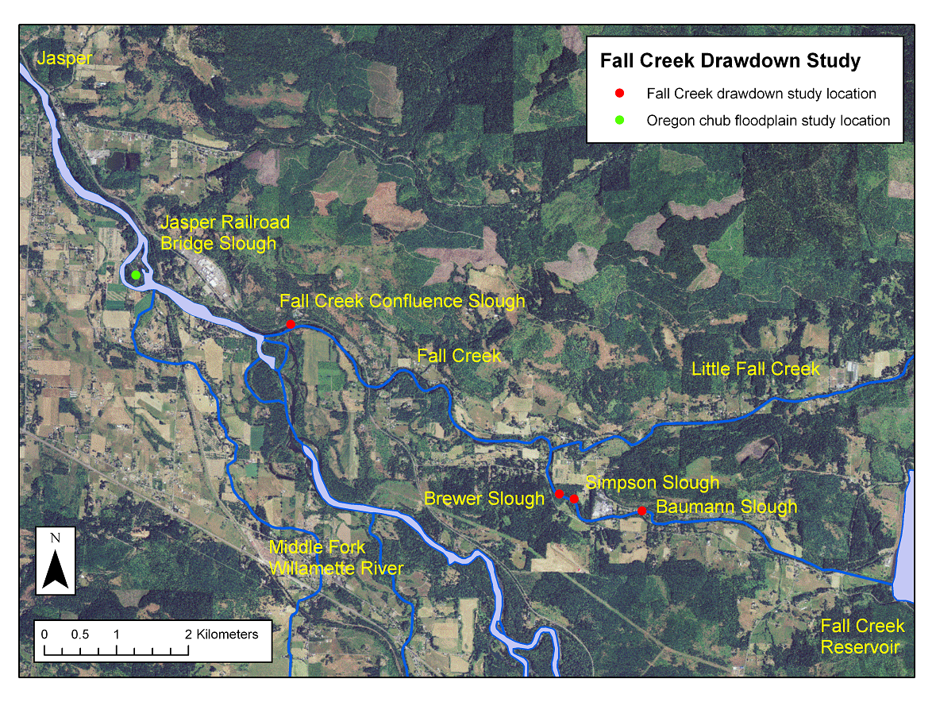

Slide 11
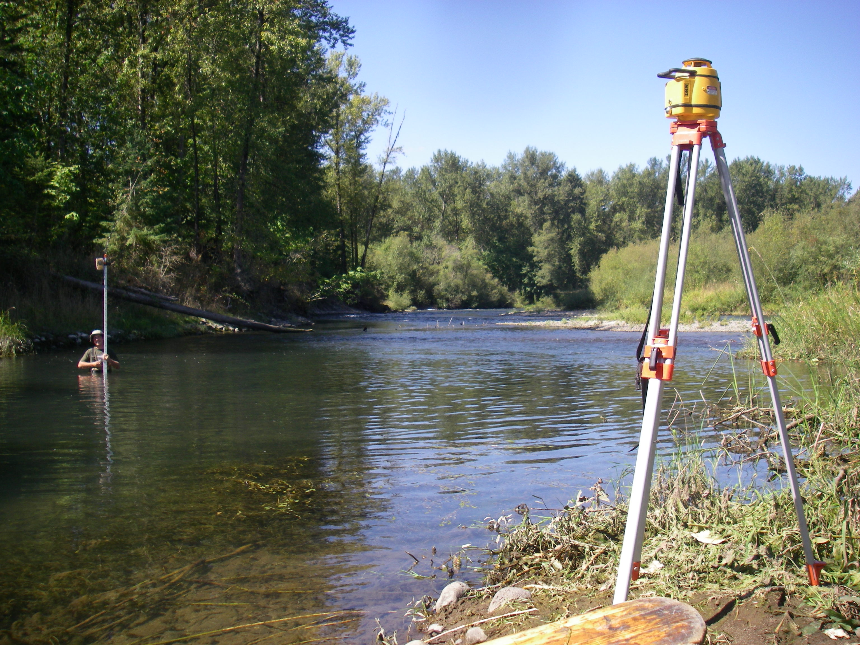
Bathymetry Mapping

Slide 12
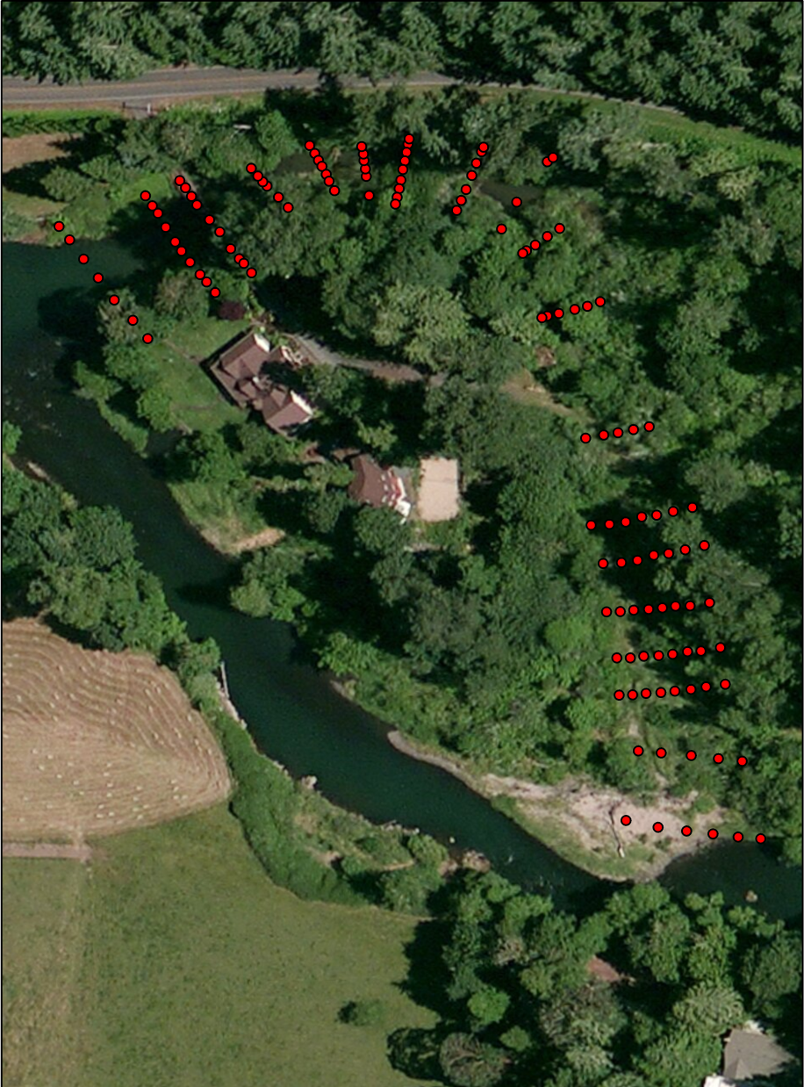
Bathymetry mapping

Slide 13
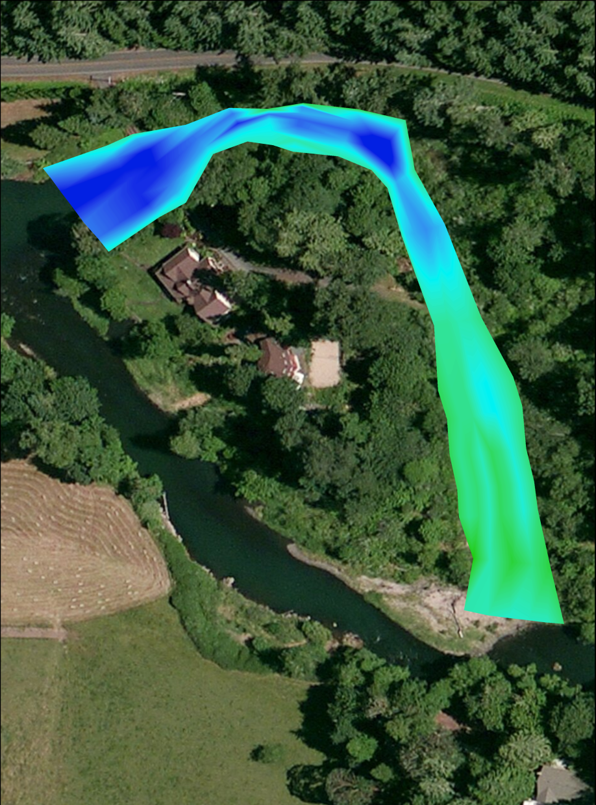
Bathymetry mapping

Slide 14
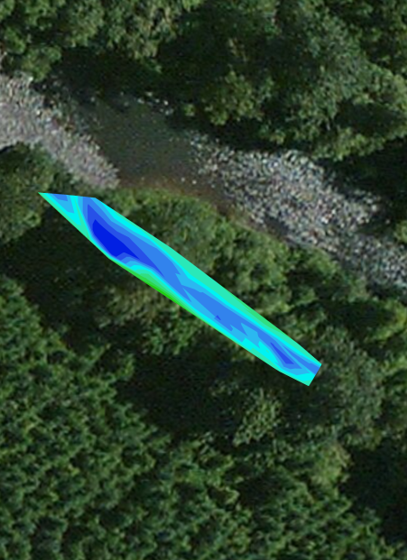
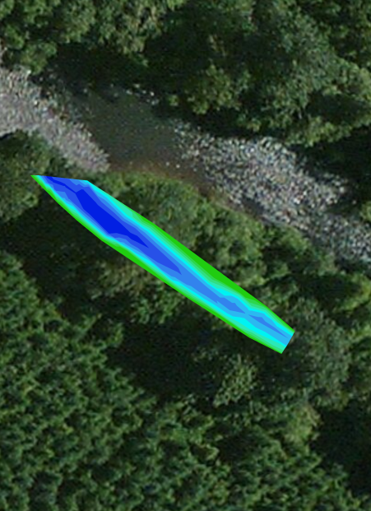
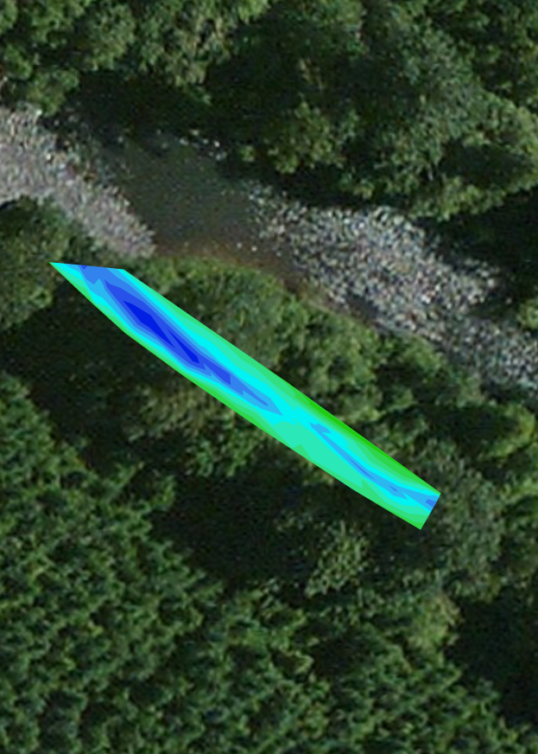
Remapping
2012
2013
2014
Annual mapping at each site

Slide 15
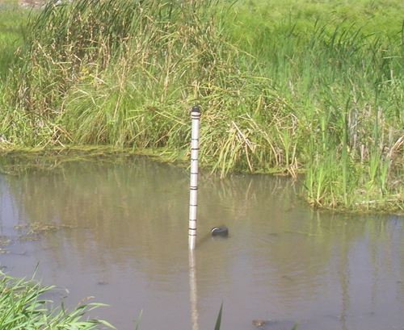
What is it good for?
With piezometer:
Points of connection
Area
Volume
Average depth (Volume/Area)
Max. depth
P

Slide 16
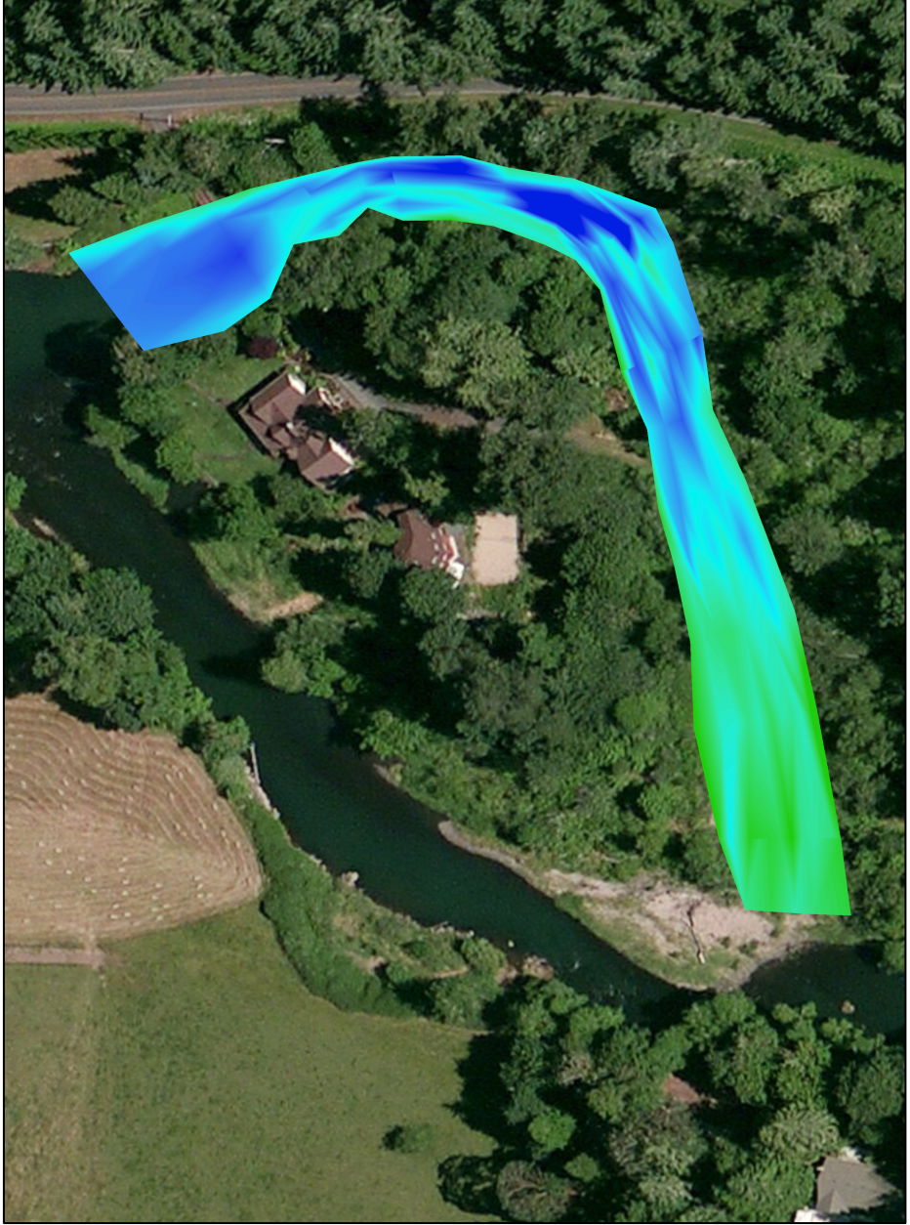


Depth Frequency Analysis
Convert TIN map to raster grid
Each cell 0.1 m², and contains elevation data
-2.5
-2.1
-1.6
-1.1
-2.3
-1.9
-1.8
-2.1
Grid is not to scale!
-0.5
-1.0
-1.3
-0.9

Slide 17
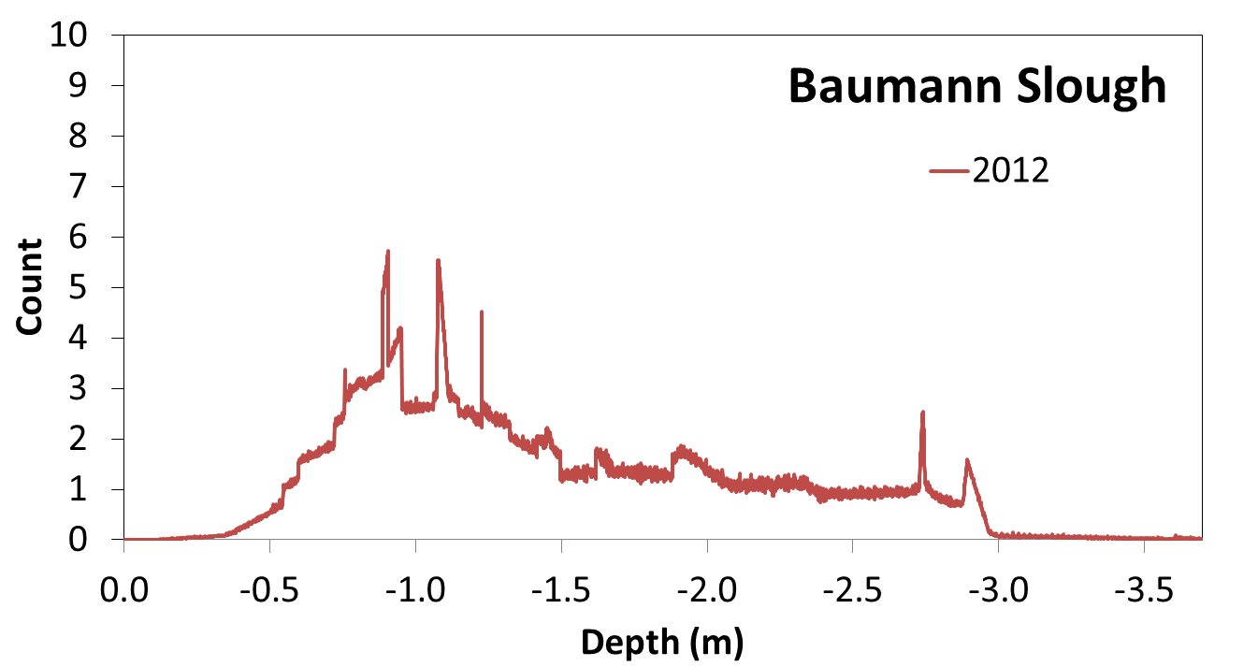
Depth frequency analysis
High terrace – shallow end
Max depth – deep end

Slide 18
Depth frequency analysis
High terrace – shallow end
Max depth – deep end

Slide 19
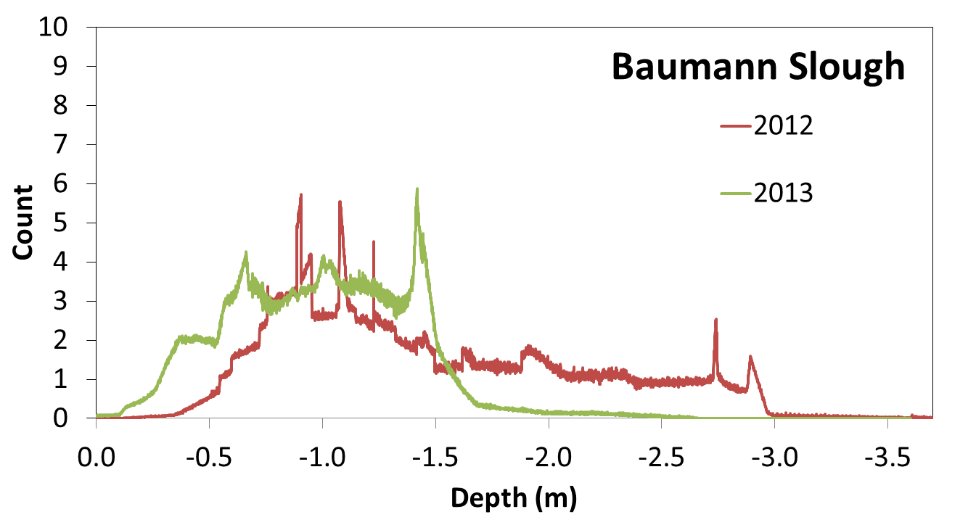
Depth frequency analysis

Slide 20
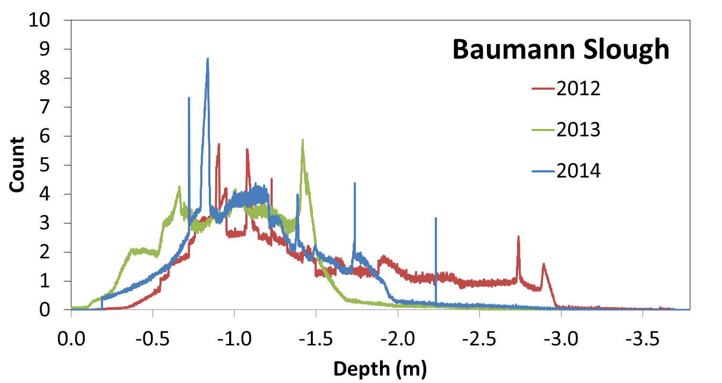
Depth frequency analysis

Slide 21
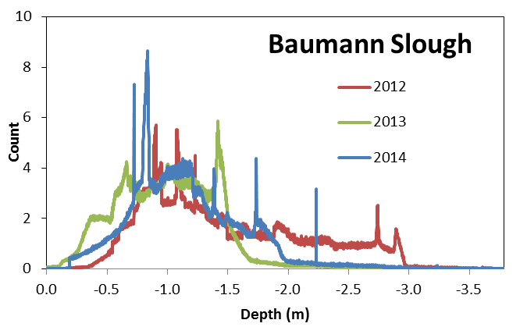
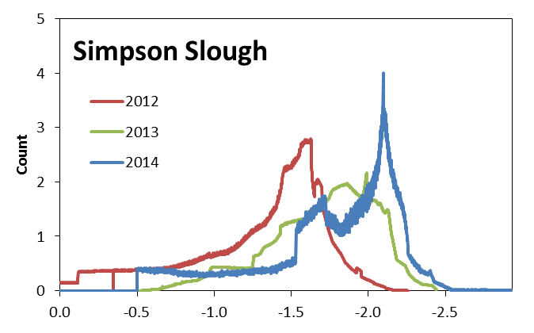
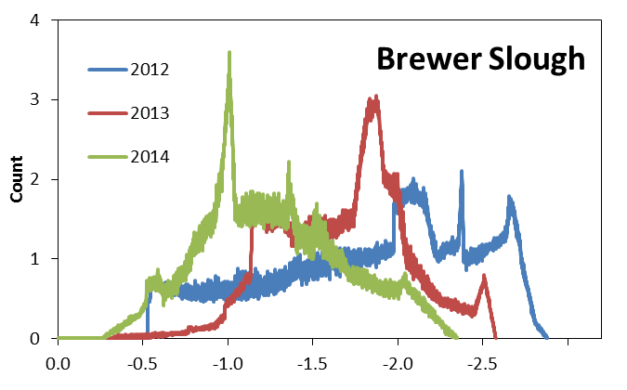
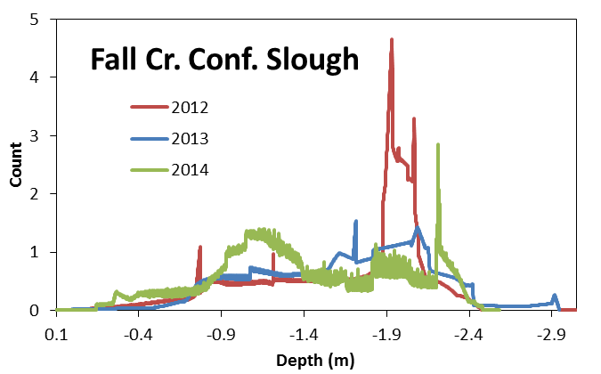
Depth frequency analysis
Detect change in area and volume

Slide 22
Depth frequency analysis
High initial sedimentation, slow scouring

Slide 23
Depth frequency analysis
Gradual scour
Sedimentation

Slide 24
Depth frequency analysis
Mixed bag
Initial sedimentation low
Some scour

Slide 25
Habitat at average summer depth
 | Area (m²) |  |  |  |  | Volume (m³)
Location | 2012 | 2013 | 2014 |  |  | 2012 | 2013 | 2014
Baumann | 1,344 | 104 | 400 |  |  | 757 | 32 | 119
Simpson | 209 | 868 | 1,031 |  |  | 25 | 201 | 290
Brewer | 1,177 | 611 | 203 |  |  | 153 | 82 | 35
Fall Cr. Conf. | 374 | 326 | 258 |  |  | 86 | 37 | 52
In 2013:
62% reduction in wetted area
66% reduction in water volume
3 locations area and vol. reduced, 1 greater
Notes:
ADD RANGE

Slide 26

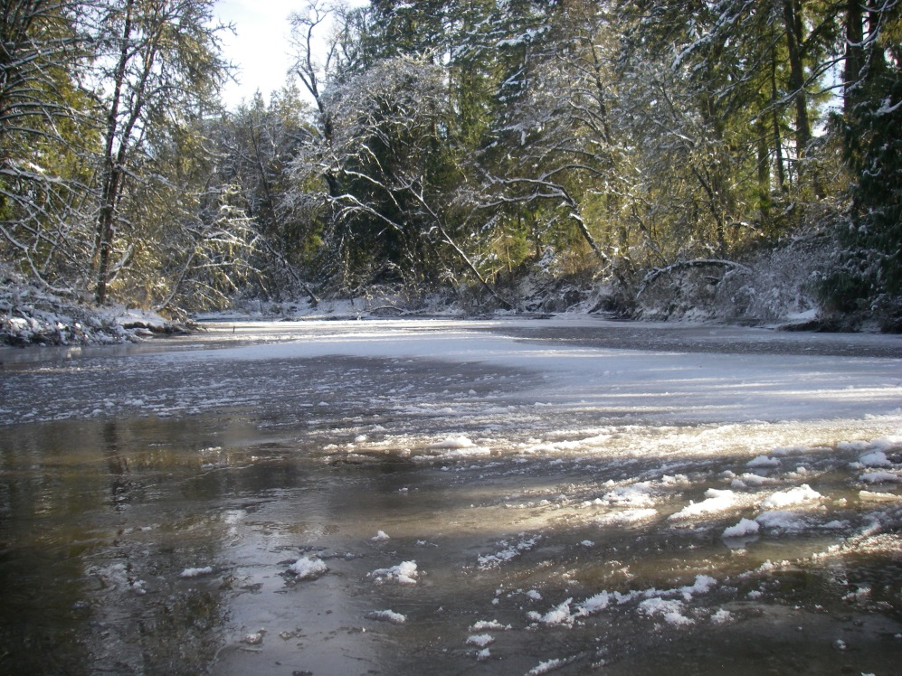
Differences: 2012 and 2013 Drawdown
2012
High flow
Lots of silt/sand
No big flow events
2013
Lower flow, frozen
Less silt/sand
High flows following

Slide 27
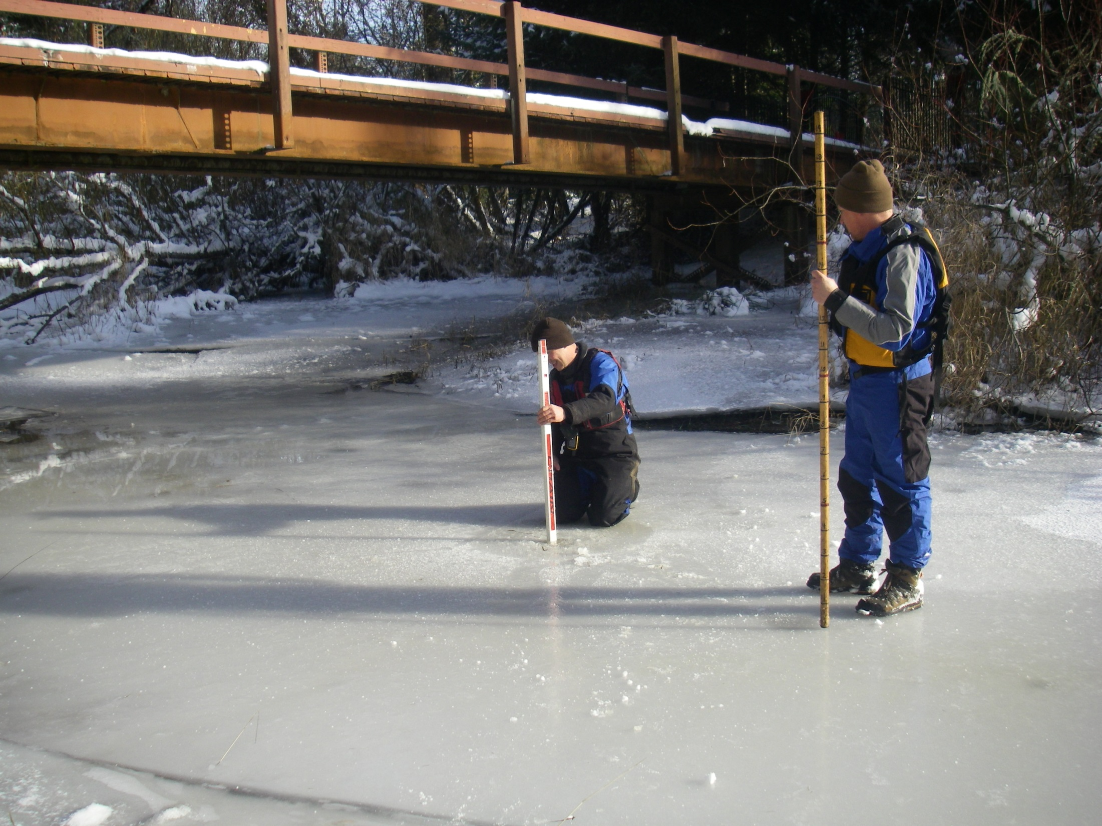

Slide 28
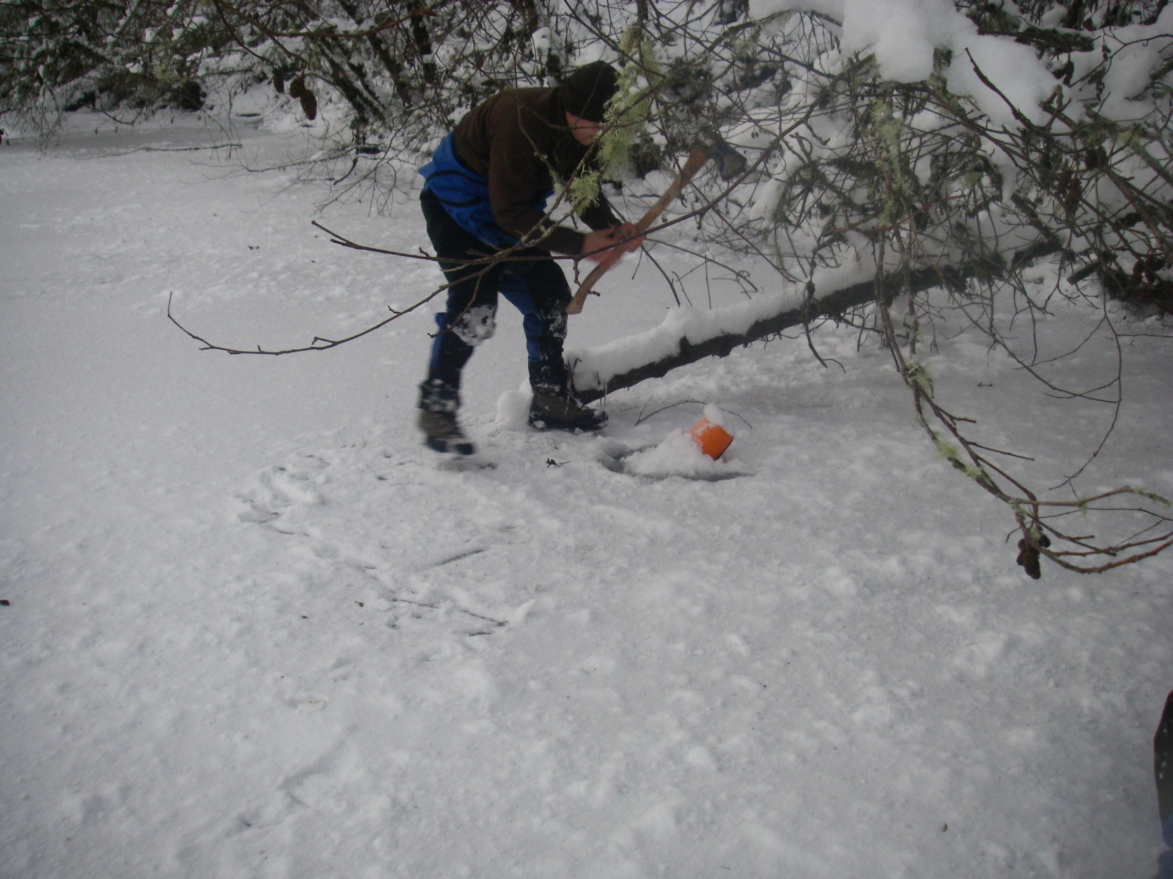

Slide 29
Habitat at average summer depth
 | Area (m²) |  |  |  |  | Volume (m³)
Location | 2012 | 2013 | 2014 |  |  | 2012 | 2013 | 2014
Baumann | 1,344 | 104 | 400 |  |  | 757 | 32 | 119
Simpson | 209 | 868 | 1,031 |  |  | 25 | 201 | 290
Brewer | 1,177 | 611 | 203 |  |  | 153 | 82 | 35
Fall Cr. Conf. | 374 | 326 | 258 |  |  | 86 | 37 | 52
Compared to 2013, in 2014:
1% reduction in wetted area
30% increase in water volume
  Thalweg
Still high sediment, compared to 2012
Notes:
ADD RANGE

Slide 30
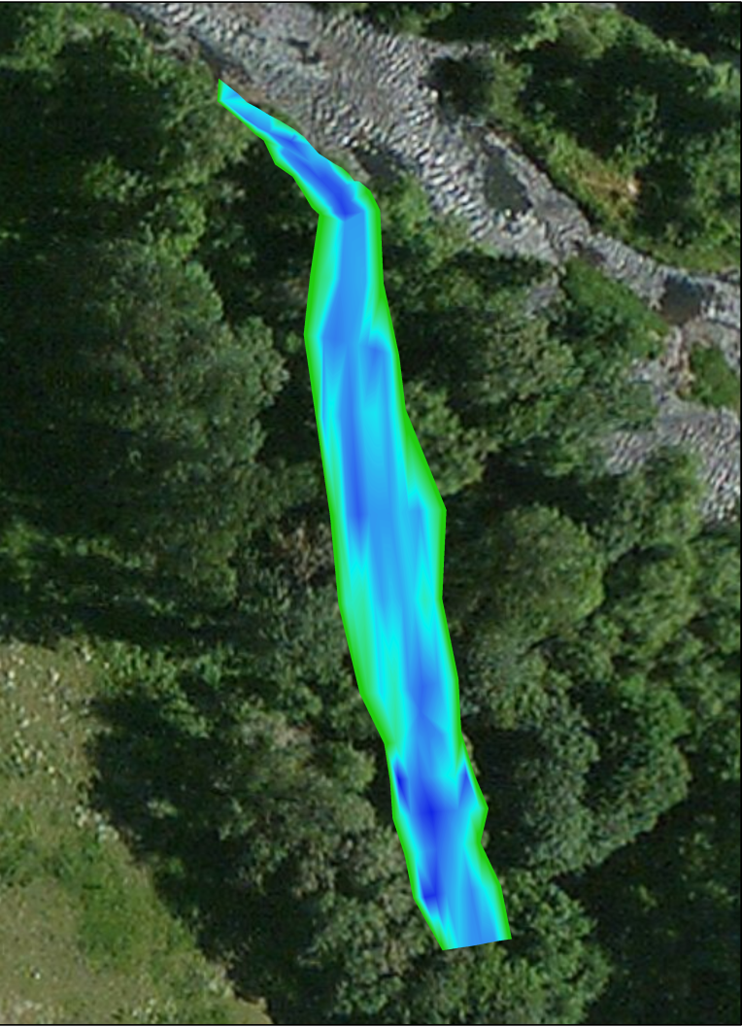
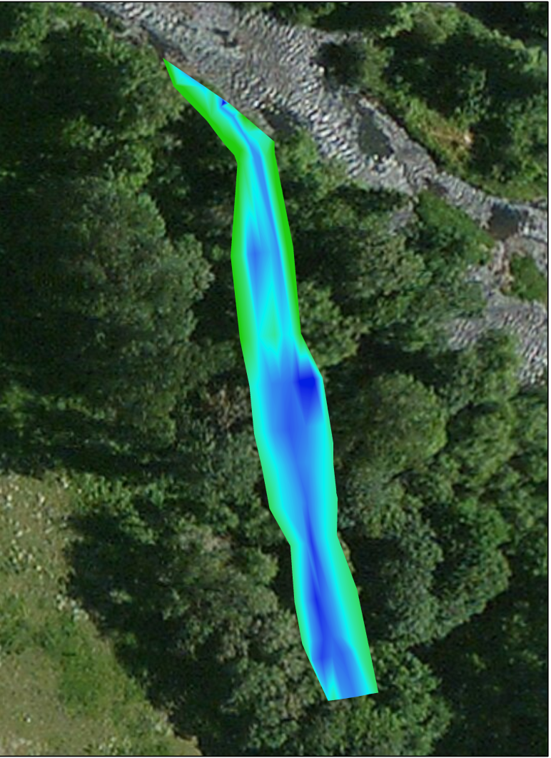
Area and vol. greater at one location
 | Area (m²) |  |  | Volume (m³)
Location | 2012 | 2013 |  | 2012 | 2013
Baumann Slough | 2,960 | 390 |  | 1,472 | 124
Simpson Slough | 63 | 151 |  | 4 | 13
Brewer Slough | 484 | 67 |  | 169 | 11
Fall Cr. Conf. Slough | 1,093 | 963 |  | 135 | 248
Sedimentation
Scour
Combined:
66% reduction in wetted area
78% reduction in water volume
Increase in wetted area and volume
Scour mid-site greater than sedimentation volume near mouth

Slide 31
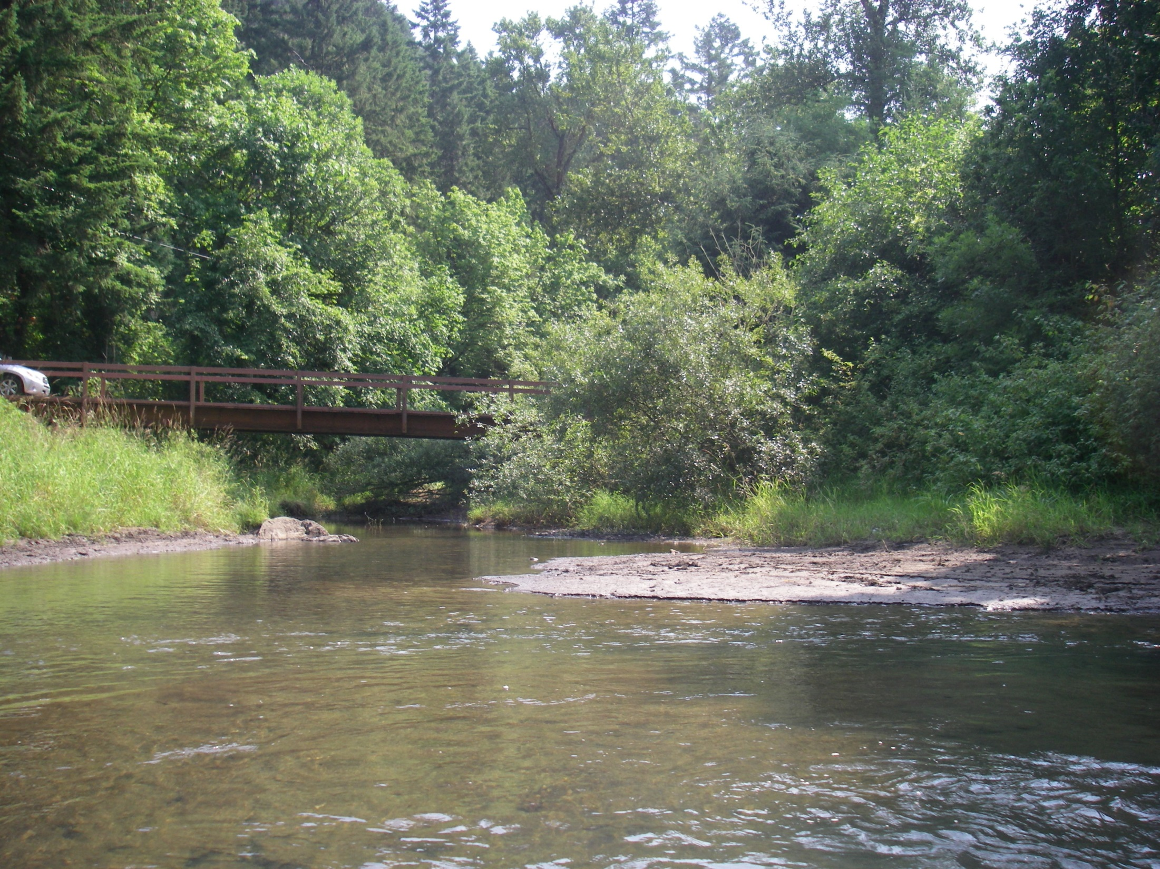
Baumann slough 7/19/2012: 152 cfs

Slide 32
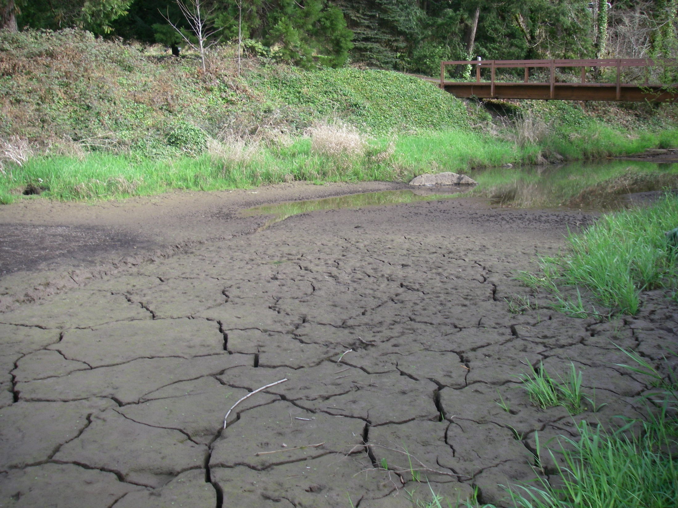
Baumann slough 4/2/2013: 68 cfs

Slide 33
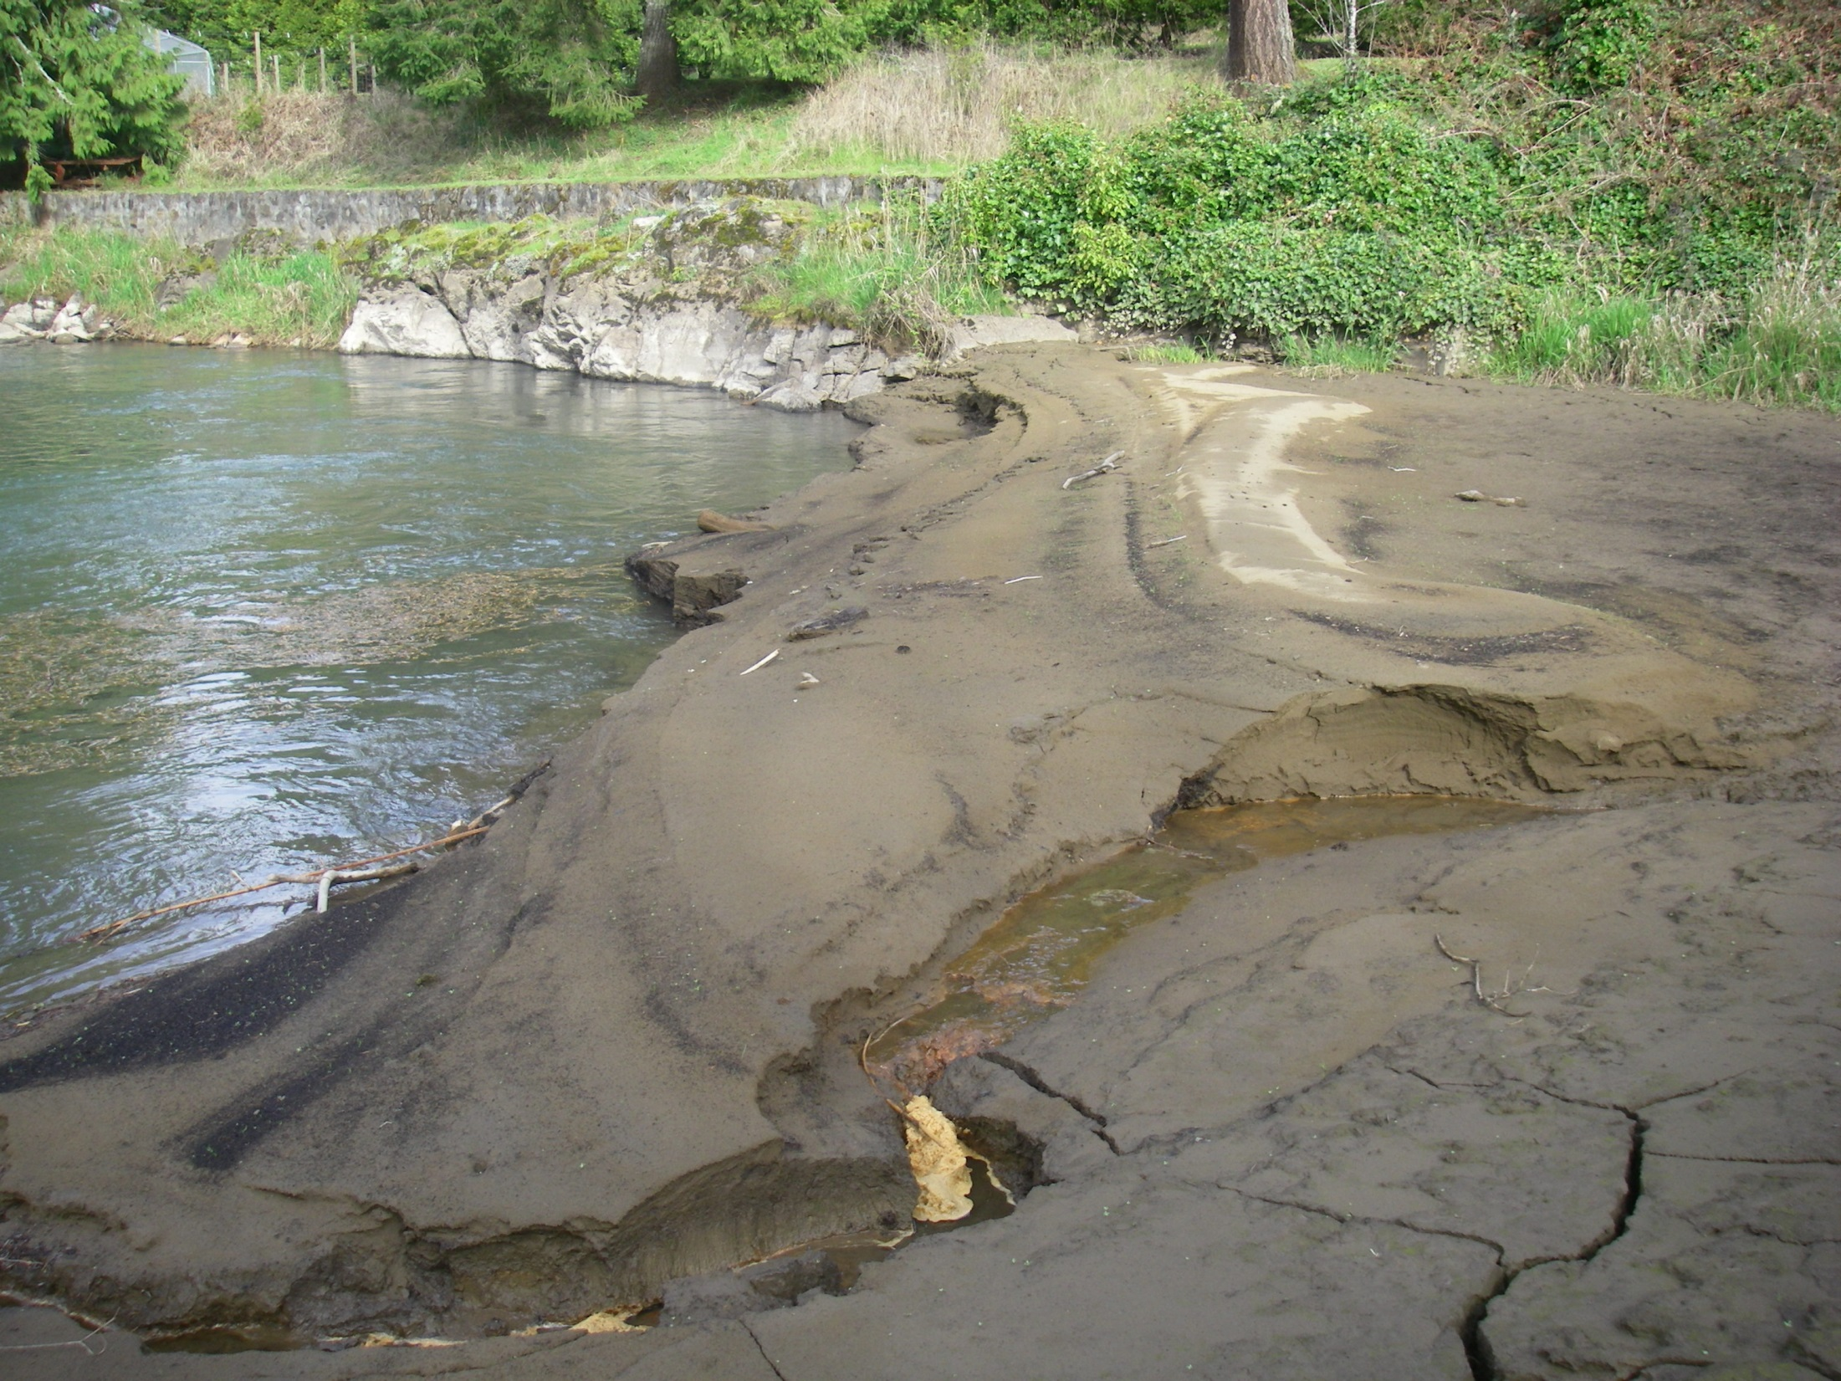
Baumann slough 4/2/2013: 68 cfs

Slide 34
Fish results
Year | Oregon chub | Redside shiner | Speckled dace | Sculpin Spp. | Northern pikeminnow | Largescale sucker | Sand roller | Rainbow trout | Brown bullhead | Bluegill | Total
2012 | 7 | 47 | 554 | 35 | 6 | 4 | 4 | 1 | 6 | 1 | 665
2013 | 2 | 7 | 57 | 22 | 2 | 22 | 1 | 15 | 3 | 11 | 142
2014 | 137 | 210 | 125 | 37 | 28 | 21 | 0 | 0 | 0 | 3 | 561
10 species encountered; Oregon chub observed at each location
2013: nearly 80% reduction from 2012 abundance
2014: rebound?
Nonnative species present, but in low abundance

Slide 35
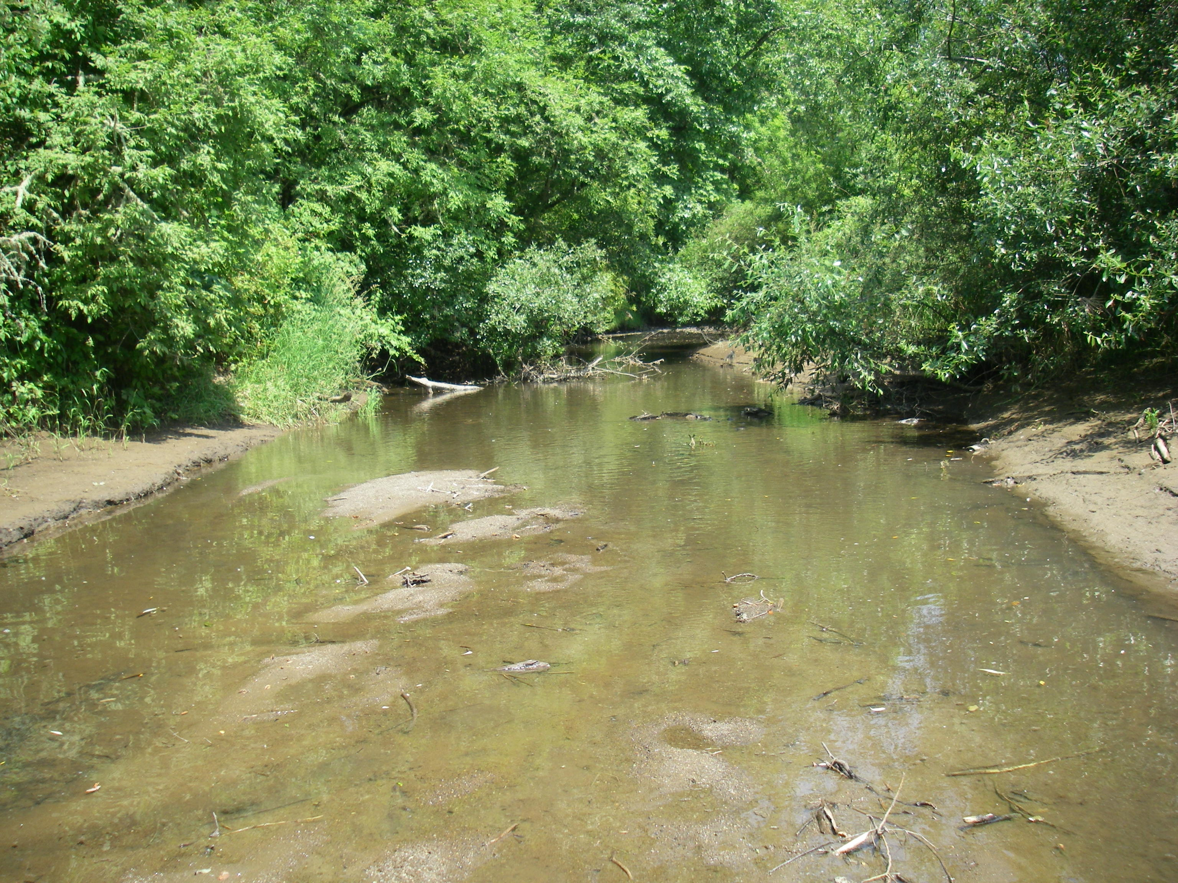
Conclusions
Concerns:
  Sedimentation has severely reduced the off-channel habitat downstream of Fall Creek Reservoir
  Current managed maximum flows may not have energy required to move fine sediment from floodplain sites.

Slide 36
Conclusions
Recommendations:
  Seek alternate management
    Completing the drawdown during low flow periods
    Draw down the reservoir, but not to run of the river
  Okay for Fall Creek, would significantly impact habitats in other subbasins

Slide 37
Future studies
Continue to monitor changes in bathymetry at Fall Creek locations
  Determine long term effect on fish assemblage
  Determine best flow regime for managing this system

Slide 38
Questions?

